Slide 1
Android Game
Unimelb H1 Hopper

Slide 2
Table of contents
Introduction
Background and Motivation
The goal
The inspiration
Demo and Techniques
Automatic language choosing
Light mode switching (light sensor)
Firebase for accessing data via internet
Game play (accelerometer, magnetometer)
Evaluation and Future Directions
Survey for evaluation
Further improvements can be made

Slide 3
01
Introduction

Slide 4
Background and Motivation
Unimelb students are surrounded by lots of assessments
Students may feel anxious and stressful because:
Assessments are too hard
Not confident enough to overcome challenges
Do not have a clear understanding of the assessments components

Slide 5
The Goal
So we aim to design a game to help students to release the pressure
The goal of the game is to:
Provide Unimelb students with more confidence that they can earn the desired score
Reinforce their understanding of the assessment component in the form of a game

Slide 6
02
Demo and Techniques

Slide 7
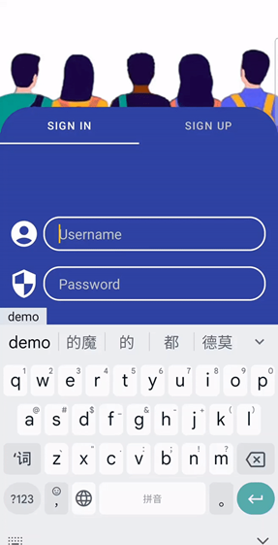
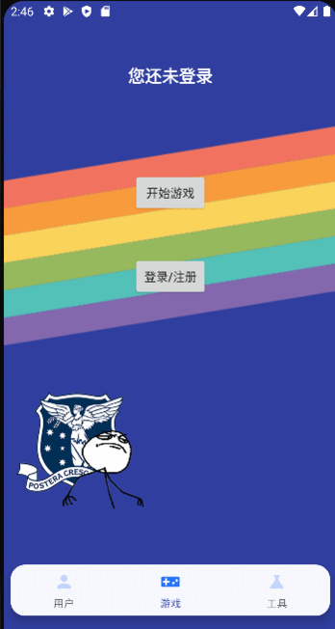
Automatic Language Choosing
The UI language changes automatically according to the system’s language.
We support six languages, including English, German, Chinese, Indonesian, French, and Japanese.

Slide 8
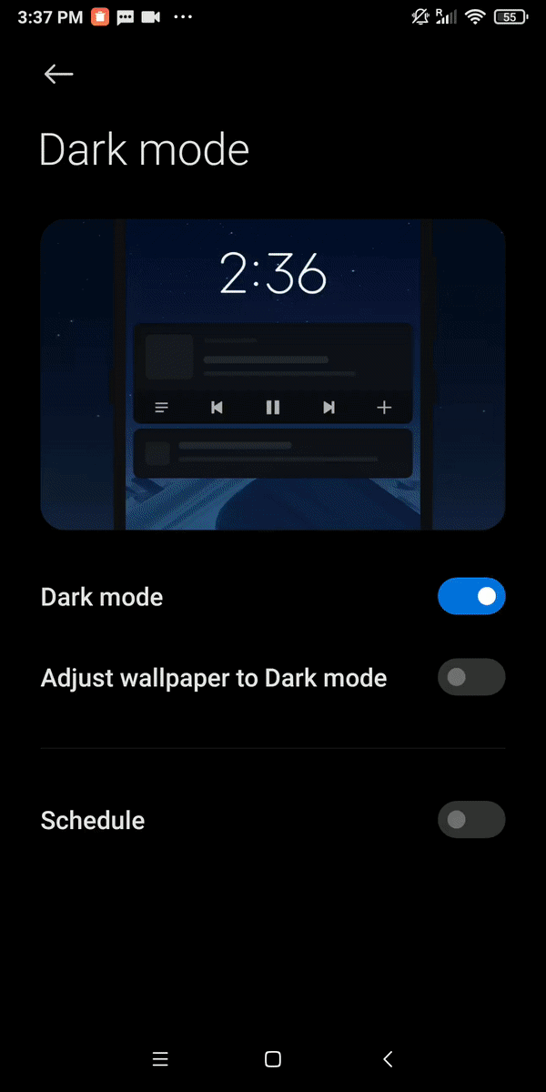
Light Mode Switching
We use the light sensor to detect ambient light.
If the ambient light does NOT match the current light mode configuration in the cell phone, the user can switch the light mode.

Slide 9
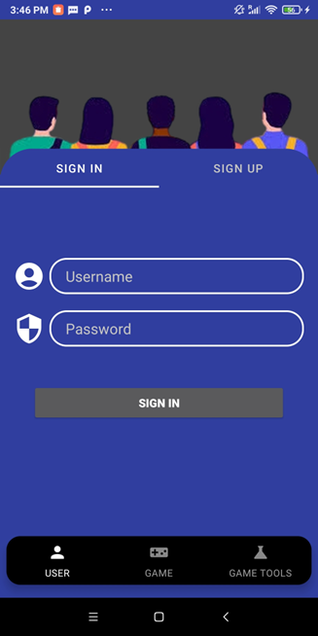
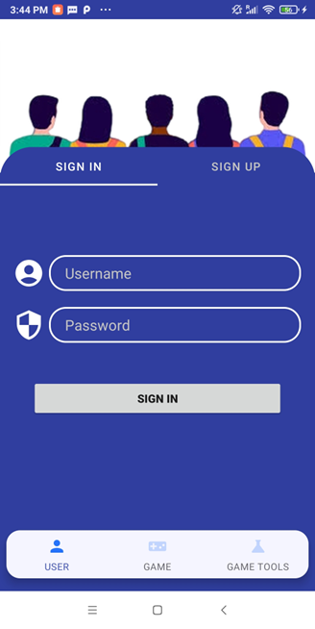
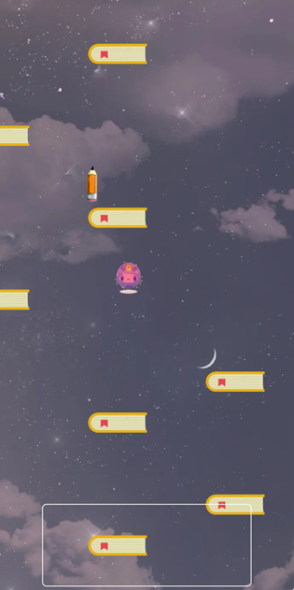
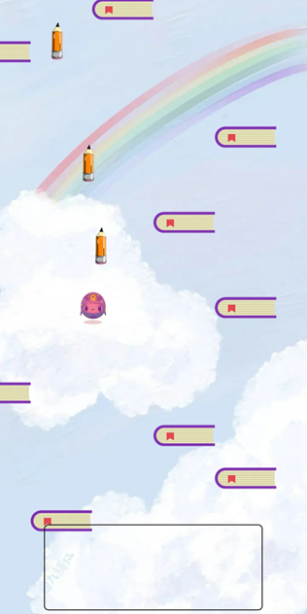
Light Mode Switching

Slide 10
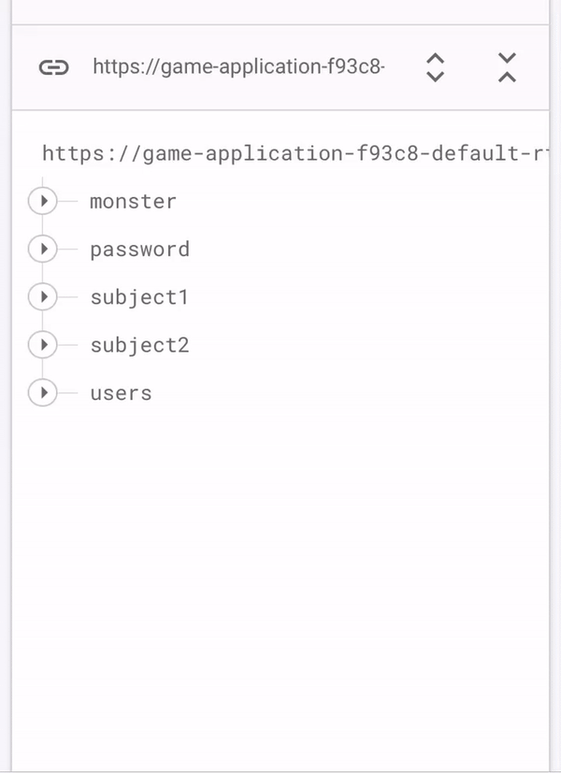
Firebase
Realtime Database: Cloud storage and host online.
Data is stored as JSON in Realtime to every users.
Easy connection with the app by the tools of android studio.
All users can share the data instance and automatically.

Slide 11
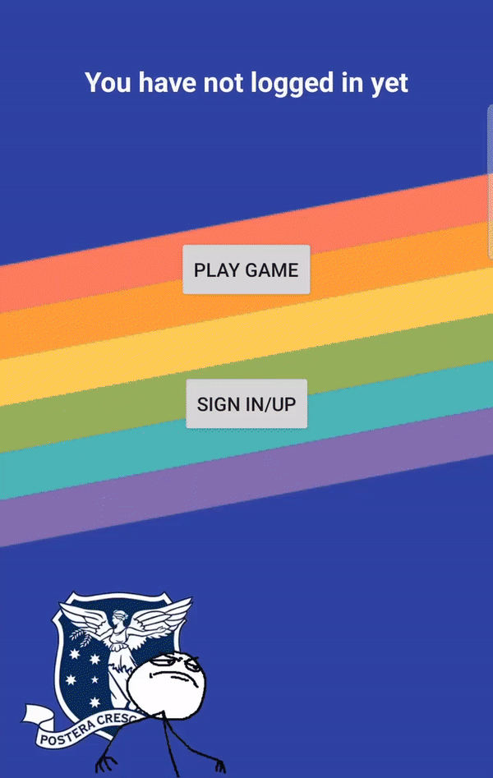
Sign Up
For the sign up page, when a user clicks the “sign up” button:
We check the confirmed password(SHA256 encryption)
We check the username
If the username haven’t used, the database will update.
All of the scores of the user will be set to “0”.
A message about if it is successful.

Slide 12
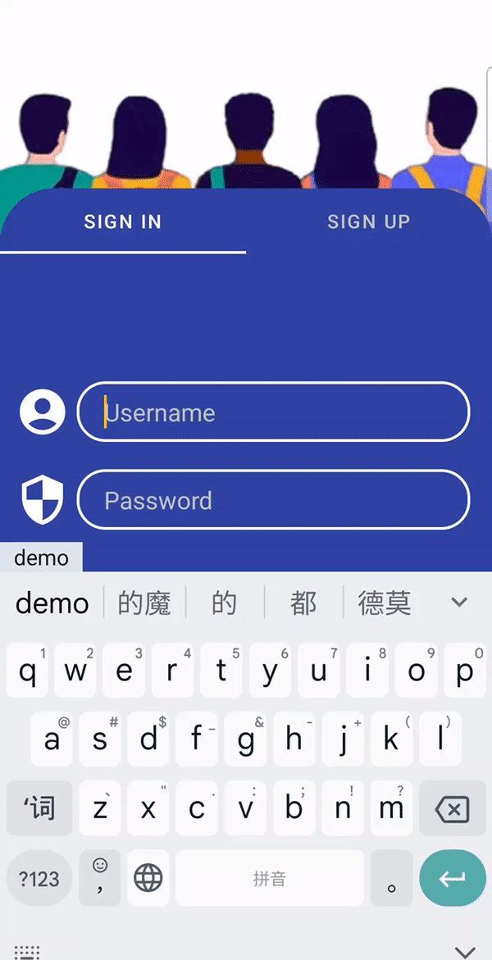
Sign In
For sign up page, when a user clicks the “sign in” button:
We check the username
We check the password
If true, login and turn to next page
log out with clicking the log out

Slide 13
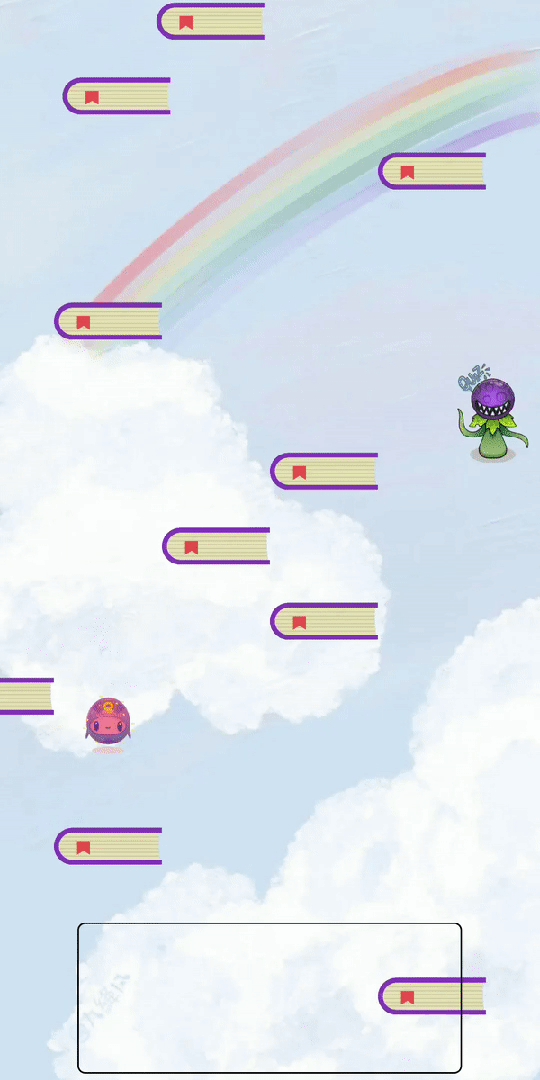
Game Playing
We use an accelerometer and magnetometer to detect the device’s real-time orientation.
The user can shoot bullets to kill the monster.

Slide 14
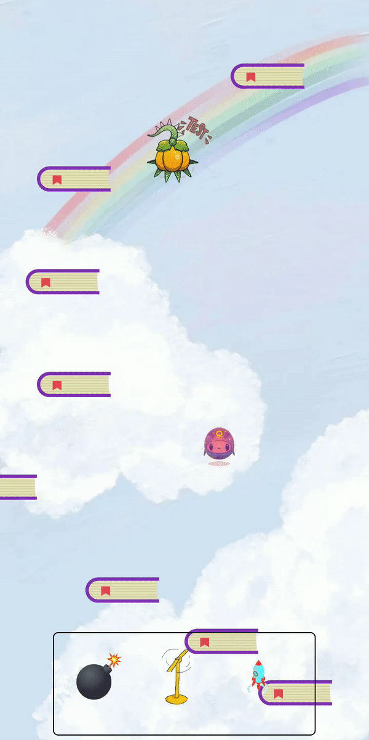
Game Playing
Users can use tools.
To finish the game, the user must kill the monster and reach the destination.

Slide 15

Monsters in Game
Monsters in the game are assignments, quizzes, tests and exams.
When users kill these monsters in the game, they will gain confidence.

Slide 16
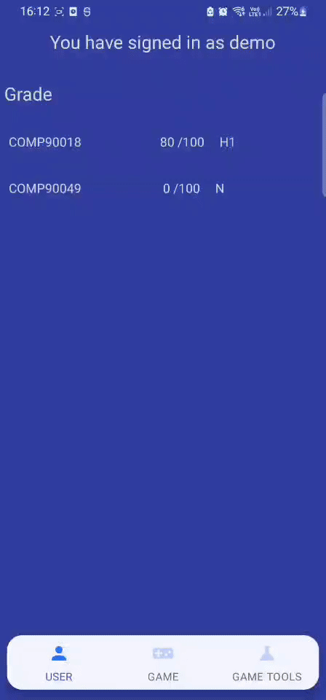
Score
The score page will show the score of the whole subject.
The firebase stores the data related to monsters appeared in each week.
Including types, positions, and values(scores)
The score is update after finishing one game.
The same grade scale as unimelb.
User never fail for their subjects.
Get a “H1” grade for this subject after finishing all the 12 weeks.

Slide 17
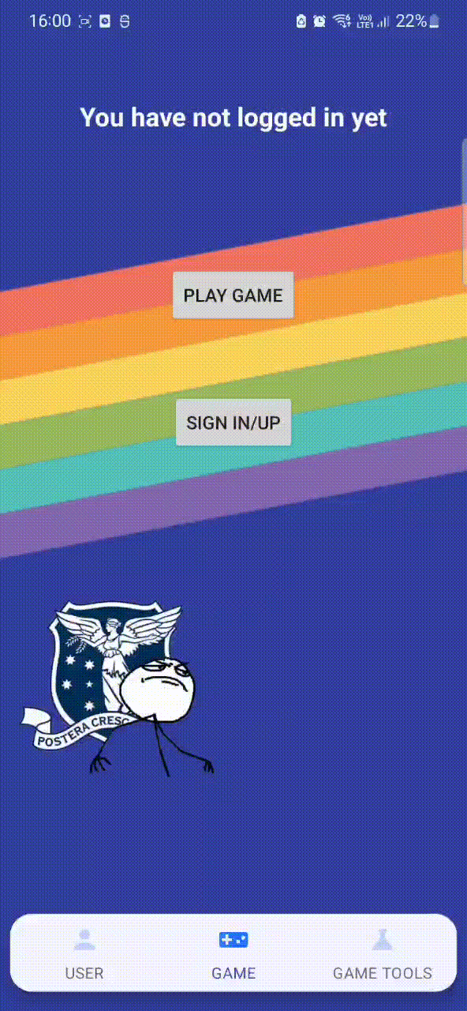
Game Tools
Two components: Tool Box Selection (Top) and Selected Tool Box (Bottom)
Three game tools: Copter, Rocket, Bomb
Game tools refresh mechanism: Reset tool
quantity
Using AlarmManager and BroadcastReceiver for Game tools refresh mechanism
Validation: No duplicate items and Cannot choose game tools with 0 quantity

Slide 18
Select Levels
If the user is logged in, user needs to select the subject and week before entering the game level.

Slide 19
Improvements Adaptable
The subject can be selected in this game and all the information about levels include monsters and layout are obtained from the Firebase database.
This way, when we update the content of the application in the future, we will not need to release a new version of the application. Once the database is updated, the content of the application will be changed accordingly.

Slide 20
Play Directly
If the user is not logged in, they can only directly enter the trial level to play.

Slide 21
03
Evaluations and
Future Directions

Slide 22
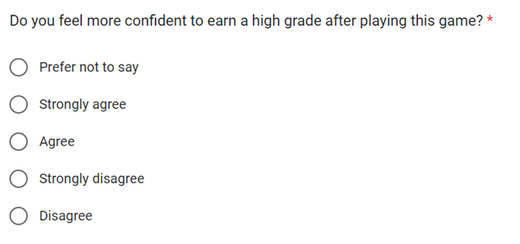
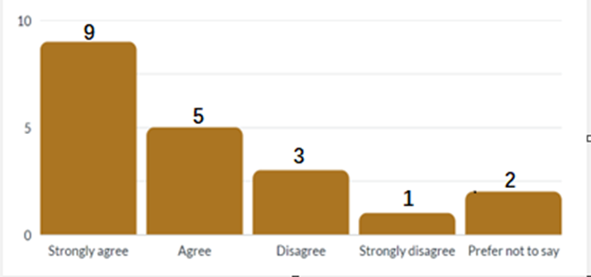
Survey

Slide 23

Future Directions
Technical Directions
Optimizing battery consumption
Providing more smooth navigation between Activities/Fragments
Product Directions
Add union and chat features to connect with other students
Collaborate with the university for Gamification
More variations of faculty and subjects
Improve features of the gameplay

Slide 24
